Slide 1
Uber Price Prediction
Sushant Deepak Parkhi

Slide 2

Ride Scanner and Prediction App
Ride Scanner is a Web App built with AngularJS to compare prices of Taxi Service: Lyft, Uber.
It also Predict the Prices if you want to leave later.
Side by Side comparison of the prices provided by the Taxi Service for each category.
Use of Official RESTful API provided by Lyft and Uber.
https://sushantparkhi.com

Slide 3
Uber
Uber is a convenient, inexpensive taxi service.
Picks you up and take to your destination.
It has various categories or services like UberPool, UberX, Uber Black et cetera.

Slide 4
Uber API
Uber Price Estimate API gives the Pricing estimate from Pickup Location Latitude, Longitude and Destination Location Latitude, Longitude.
It gives Current Time Pricing Estimate.
Endpoint https://api.uber.com/v1/estimate/price?start_latitude={}&start_longitude={}&end_latitude={}&end_longitude

Slide 5
Uber API Results

Slide 6
UberPool
UberPOOL allows you to share your ride.
It splits the cost of your trip with another ride headed for the same direction.

Slide 7
Mining Process
Start Area
Calculate Derived Position
Uber API
Result
Database

Slide 8
Mining Process

Slide 9
Mining Process : Start Destination
Made a List of around 116 Neighborhoods in Boston and Cambridge Area.
Few Example, Packard’s Corner, Allston, Brighton, Boston University, Cambridge East, MIT et cetera.
Used the Latitude Longitude of these Location as the Start Destination

Slide 10
Mining Process : Destination
Calculated the Derived Positions Latitude Longitude using Haversine Formula.
Calculated for 2, 4, 6, 8 and 10 miles Distances.
When Passed with Start Latitude, Longitude and Bearing it gives the Derived Latitude, Longitude based on Distance value.

Slide 11
Mining Process : Date Time
Repeated all the Steps for the whole day.
Collected Data for all the Neighborhoods with a Gap of 5 Minutes.

Slide 12
Mining Process : Storage
MongoDb is a free and open-source to store NoSQL data.
I collected the Data for 7 Days from Morning to Evening.
176,000 Documents has been collected.

Slide 13
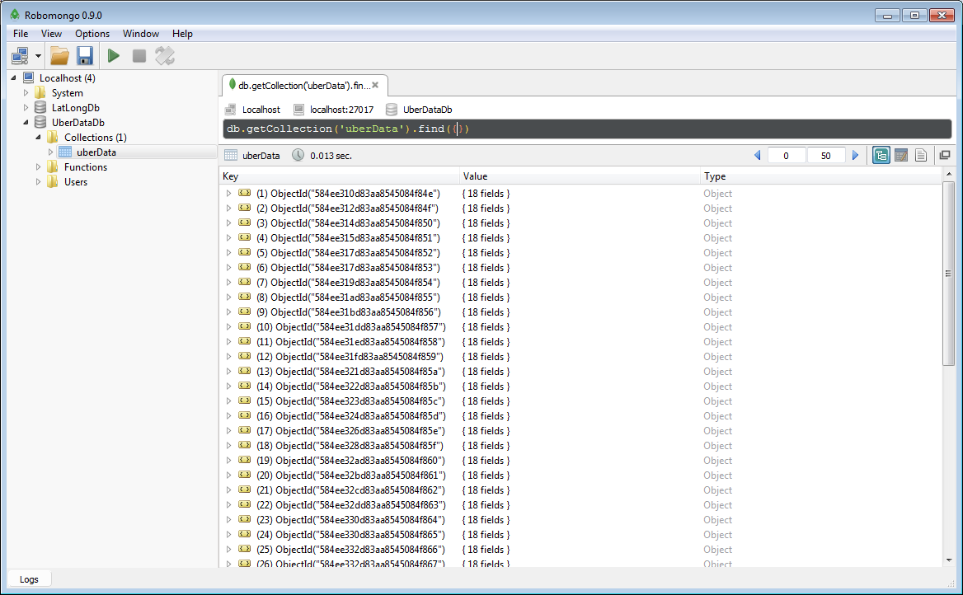
Mining Process : Storage

Slide 14
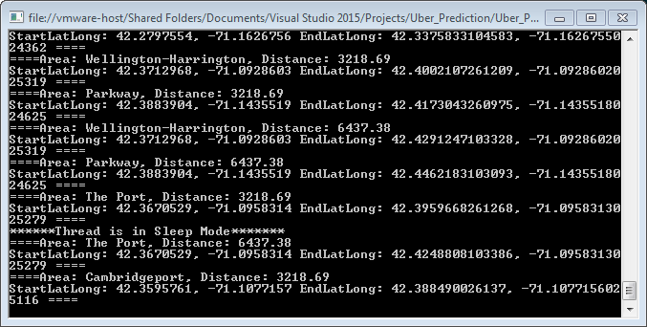
Mining Process : Script
Build using C# make Calls to APIs and Store to Mongo Dataset

Slide 15
Prediction and Analysis Process
Pickup Latitude Longitude
Predicted Price
Distance
R Script
Hour
Data Frames for Plotting
Day

Slide 16
R Script
MongoDb Dataset used as a csv file.
Filtered the Data by calculating the nearest Neighborhood available in Dataset
Created Regression Model using the Dataset.
Returns the Predicted Price based on Distance and other Data Frame

Slide 17
R Script

Slide 18
R Script : Data Frame

Slide 19
OpenCPU
JavaScript Library to Execute R on Web App.
Simple RPC and Data I/O via AJAX.
Returns the Data in the JSON Format.

Slide 20
OpenCPU

Slide 21
Usage
JSON Data

Slide 22
Usage

Slide 23
Demo
https://sushantparkhi.com

Slide 24
Thank You
Sushant Deepak Parkhi

